Slide 1
COMPUTER NETWORKS
Unit-1
Network hardware
Network software
OSI, TCP/IP Reference models
Example Networks: ARPANET, Internet
Physical Layer: Guided Transmission media: twisted pairs, coaxial cable, fiber optics,
Un-Guided Transmission media: Wireless transmission.

Slide 2
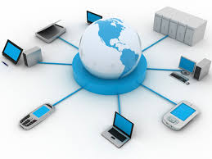
INTRODUCTION TO COMPUTER NETWORKS
A network is a set of devices (often referred to as nodes) connected by communication links(Wired and wireless). A node can be a computer, printer, or any other device capable of sending and/or receiving data generated by other nodes on the network.

Slide 3
USES OF COMPUTER NETWORKS/APPLICATIONS OF COMPUTER NETWORKS
Major application areas of computer network are as follows:
Business Applications
Home Applications
Mobile users
Social media
1. Business Applications
Following are some business applications of computer networks:
  Resource Sharing:
The goal is to make all programs, equipments(like printers etc), and especially data, available to anyone the network without regard to the physical location of the resource and the user. So, sharing a resource to any device over a network.

Slide 4
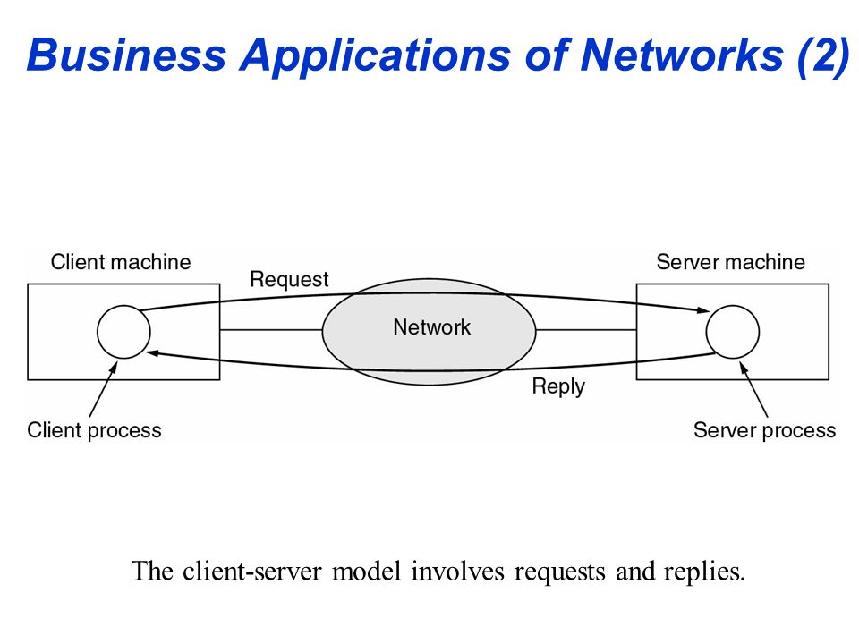
b. Server-Client model:
One can imagine a company's information system as consisting of one or more databases and some employees who need to access it remotely.
In this model, the data is stored on powerful computers called Servers.Server is maintained by a system administrator. In contrast, the employees have simple machines, called Clients, on their desks, using which they access remote data.

Slide 5
c. Communication Medium:
A computer network can provide a powerful communication medium among employees. Virtually every company that has two or more computers now has e-mail (electronic mail), which employees generally use for a great deal of daily communication.
d. eCommerce:
Computer network is important in business. We can do the business over the internet.
Doing business electronically with other companies.
Doing business with consumers over the Internet.
Ex: amazon.com is doing their business over the internet.

Slide 6
2. Home Applications
Homes contain many networked devices, e.g., computers, TVs, connected to the Internet by cable, DSL, wireless, etc. Home users communicate, e.g., social networks.
Some application use the peer-to-peer model in which there are no fixed clients and servers.
Some of the most important uses of the Internet for home users are as follows:
    Access to remote information
    Person-to-person communication
    Interactive entertainment
    Electronic commerce

Slide 7
Access to remote information
It comes in many forms. It can be surfing the World Wide Web for information. It include online newspaper, accessing digital library.
b. Person-to-person communication
It includes E-mail, instant messaging, discussion using worldwide newsgroups, chat rooms etc.
Here every person can communicate with one or more other people.

Slide 8
c. Interactive entertainment
which is a huge and growing industry which includes video on demand, live television etc.
d. Electronic commerce
In home applications, buy or sell items, pay bills, manage bank accounts, pay taxes, transfer funds and handle investments electronically.

Slide 9
3. Mobile users
The rapidly growing sectors in computer applications are mobile devices like notebook computers and PDAs (personal digital assistants). Here mobile users/device means portable device. The computer network is widely used in smartwatches, wearable devices, tablets, online transactions, purchasing or selling products online, etc.
4. Social media
Social media is also a great example of a computer network application. It helps people to share and receive any information related to political, ethical, and social issues.

Slide 10
Components of Computer Networks
A data communications system has five components
1. Message: The message is the information (data) to be communicated. Popular forms of information include text, numbers, pictures, audio, and video.
2. Sender: The sender is the device that sends the data message. It can be a computer, workstation, telephone handset, video camera, and so on.
3. Receiver: The receiver is the device that receives the message. It can be a computer, workstation, telephone handset, television, and so on.

Slide 11
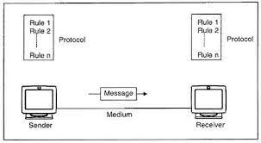
4. Transmission medium: The transmission medium is the physical path by which a message travels from sender to receiver. Some examples of transmission media include twisted-pair wire, coaxial cable, fiber-optic cable, and radio waves.
5. Protocol: A protocol is a set of rules that govern data communications. It represents an agreement between the communicating devices. Without a protocol, two devices may be connected but not communicating, just as a person speaking French cannot be understood by a person who speaks only Japanese.

Slide 12
Data flow in communication system or transmission modes
The way in which data is transmitted from one device to another device is known as transmission mode.
The transmission mode is also known as the communication mode.
Each communication channel has a direction associated with it, and transmission media provide the direction. Therefore, the transmission mode is also known as a directional mode.
The transmission mode is defined in the physical layer.
The Transmission mode is divided into three categories:
  Simplex mode
  Half-duplex mode
  Full-duplex mode

Slide 13

  Simplex mode
In Simplex mode, the communication is unidirectional, i.e., the data flow in one direction.
A device can only send the data but cannot receive it or it can receive the data but cannot send the data.
The radio station is a simplex channel as it transmits the signal to the listeners but never allows them to transmit back.

Slide 14
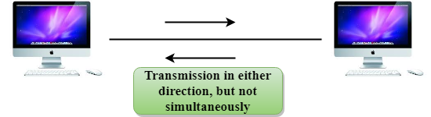
  2. Half-duplex mode
In a Half-duplex channel, direction can be reversed, i.e., the station can transmit and receive the data as well.
Messages flow in both the directions, but not at the same time.
The entire bandwidth of the communication channel is utilized in one direction at a time.
In half-duplex mode, it is possible to perform the error detection, and if any error occurs, then the receiver requests the sender to retransmit the data.

Slide 15
Keyboard and Monitor are the examples of the simplex mode as a keyboard can only accept the data from the user and monitor can only be used to display the data on the screen.
Advantage of Simplex mode:
In simplex mode, the station can utilize the entire bandwidth of the communication channel, so that more data can be transmitted at a time.
Disadvantage of Simplex mode:
Communication is unidirectional, so it has no inter-communication between devices.

Slide 16
A Walkie-talkie is an example of the Half-duplex mode. In Walkie-talkie, one party speaks, and another party listens. After a pause, the other speaks and first party listens. Speaking simultaneously will create the distorted sound which cannot be understood.
Advantage of Half-duplex mode:
In half-duplex mode, both the devices can send and receive the data and also can utilize the entire bandwidth of the communication channel during the transmission of data.
Disadvantage of Half-Duplex mode:
In half-duplex mode, when one device is sending the data, then another has to wait, this causes the delay in sending the data at the right time.

Slide 17

3. Full duplex mode
In Full duplex mode, the communication is bi-directional, i.e., the data flow in both the directions.
Both the stations can send and receive the message simultaneously.
Full-duplex mode has two simplex channels. One channel has traffic moving in one direction, and another channel has traffic flowing in the opposite direction.
The Full-duplex mode is the fastest mode of communication between devices.

Slide 18
The most common example of the full-duplex mode is a telephone network. When two people are communicating with each other by a telephone line, both can talk and listen at the same time.
Advantage of Full-duplex mode:
Both the stations can send and receive the data at the same time.
Disadvantage of Full-duplex mode:
If there is no dedicated path exists between the devices, then the capacity of the communication channel is divided into two parts.

Slide 19
Computer Network Architecture
Computer Network Architecture is defined as the physical and logical design of the software, hardware, protocols, and media of the transmission of data. Simply we can say that how computers are organized and how tasks are allocated to the computer.
The two types of network architectures are used:
Peer-To-Peer network
Client/Server network

Slide 20
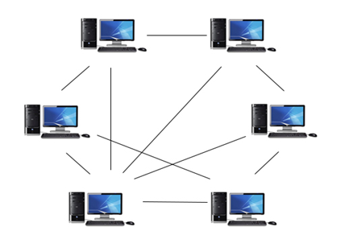
1. Peer-To-Peer network
Peer-To-Peer network is a network in which all the computers are linked together with equal privilege and responsibilities for processing the data.
Peer-To-Peer network has no dedicated server.
If one computer stops working but, other computers will not stop working.
Special permissions are assigned to each computer for sharing the resources.

Slide 21
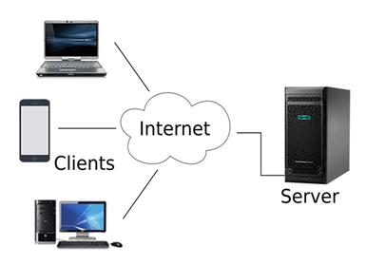
2. Client/Server network
Client/Server network is a network model designed for the end users called clients, to access the resources such as songs, video, etc. from a central computer known as Server.
The central controller is known as a server while all other computers in the network are called clients.
A server performs all the major operations such as security and network management.
A server is responsible for managing all the resources such as files, directories, printer, etc.

Slide 22
Advantages Of Client/Server network:
A Client/Server network contains the centralized system. Therefore we can back up the data easily.
A Client/Server network has a dedicated server that improves the overall performance of the whole system.
Security is better in Client/Server network as a single server administers the shared resources.
It also increases the speed of the sharing resources.
Disadvantages Of Client/Server network:
Client/Server network is expensive as it requires the server with large memory.
A server has a Network Operating System(NOS) to provide the resources to the clients, but the cost of NOS is very high.
It requires a dedicated network administrator to manage all the resources.

Slide 23
Network Hardware Components
Different components are used to create a computer network. The main components used to form a computer network are Hardware components and Software components.
Hardware components such as Computer, Transmission devices such as NIC, hub, switch, bridge, gateway, repeater, and router, Channels such as wires, microwaves, radio waves, and satellite, and Software such as NOS(network operating system) and communication Protocols are the required components to create a network.
Network hardware components are required for communication and interaction between devices on a computer network.
Some important network components are NIC, switch, cables, hub, router, repeaters, gateway, bridge and modem. Depending on the type of network that we need to install, some network components can also be removed.
For example, the wireless network does not require a cable.

Slide 24
NIC(Network interface card )
A network interface card (NIC) is a hardware component without which a computer cannot be connected over a network.
It is a circuit board installed in a computer that provides a dedicated network connection to the computer. It is also called network interface controller, network adapter or LAN adapter.
Purpose
NIC allows both wired and wireless communications.
NIC allows communications between computers connected via local area network (LAN) as well as communications over large-scale network through Internet Protocol (IP) address.

Slide 25
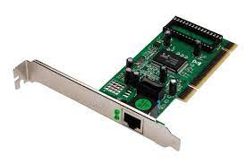
Fig: NIC
Wired NIC: The Wired NIC is present inside the motherboard. Cables and connectors are used with wired NIC to transfer data.
Wireless NIC: The wireless NIC contains the antenna to obtain the connection over the wireless network. For example, laptop computer contains the wireless NIC.

Slide 26
2. Hub
A Hub is a hardware device that divides the network connection among multiple devices.
When computer requests for some information from a network, it first sends the request to the Hub through cable. Hub will broadcast this request to the entire network. All the devices will check whether the request belongs to them or not. If not, the request will be dropped.
The process used by the Hub consumes more bandwidth and limits the amount of communication. Nowadays, the use of hub is obsolete, and it is replaced by more advanced computer network components such as Switches, Routers.
Hub uses half duplex transmission mode.
Hub can have maximum 4 ports.

Slide 27
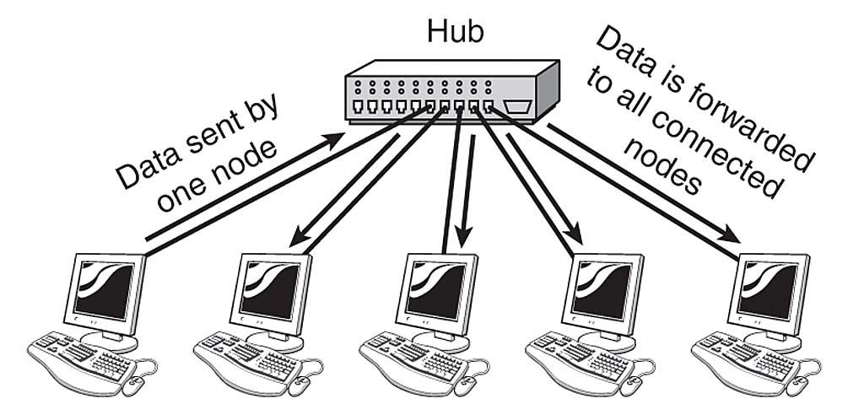

Slide 28
3. Switch
A switch is a hardware device that connects multiple devices on a computer network.
A Switch contains more advanced features than Hub.
The Switch contains the updated table that decides where the data is transmitted or not.
Switch delivers the message to the correct destination based on the physical address(MAC) present in the incoming message.
A Switch does not broadcast the message to the entire network like the Hub.
It determines the device to whom the message is to be transmitted. Therefore, we can say that switch provides a direct connection between the source and destination. It increases the speed of the network.
Switch uses full duplex transmission mode.
Switch can have 24 to 28 ports.

Slide 29
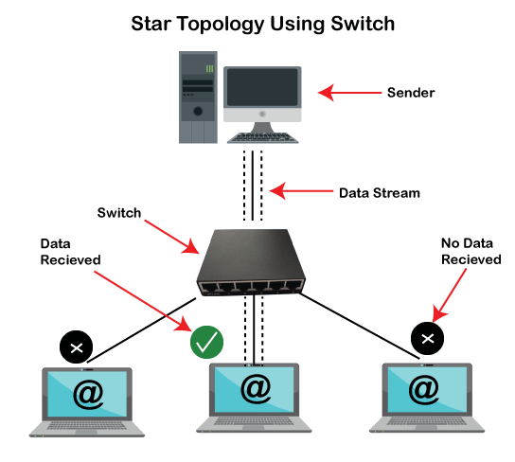

Slide 30
4. Router
A router is a hardware device which is used to connect a LAN with an internet connection. It is used to receive, analyze and forward the incoming packets to another network.
A router works in a Layer 3 (Network layer) of the OSI Reference model.
A router forwards the packet based on the information available in the routing table.
It determines the best path from the available paths for the transmission of the packet.

Slide 31
Why Routers?
A router is more capable as compared to other network devices, such as a hub, switch, etc., as these devices are only able to execute the basic functions of the network.
For example, a hub is a basic networking device that is mainly used to forward the data between connected devices, but it cannot analyze or change anything with the transferring data.

Slide 32
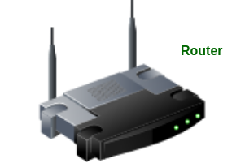
On the other hand, the router has the capability to analyze and modify the data while transferring it over a network, and it can send it to another network.
For example, generally, routers allow sharing a single network connection between multiple devices.

Slide 33
5. Modem
It stands for Modulator/Demodulator. It converts the digital data into an analog signal over the telephone lines.
A modem is a hardware device that allows the computer to connect to the internet over the existing telephone line.
A modem is not integrated with the motherboard rather than it is installed on the PCI slot found on the motherboard.
Based on the differences in speed and transmission rate, a modem can be classified in the following categories:
    Standard PC modem or Dial-up modem
    Cellular Modem
    Cable modem

Slide 34
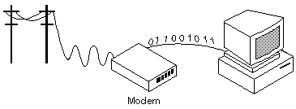

Slide 35
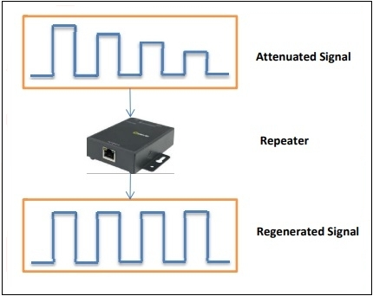
6. Repeaters
Repeaters are network devices operating at physical layer of the OSI model that amplify or regenerate an incoming signal before retransmitting it.
They are incorporated in networks to expand its coverage area. They are also known as signal boosters.

Slide 36
Ex: When the signals travels in the network, after travelling some distance the intensity of the signal becomes low. In order to regenerate the weak signal we should use repeater device.
It is cheaper than other network devices
Repeaters has the ability to extend the length of signal.
It maintain the signal performance.
Repeater can’t reduce the network traffic
Repeaters also unable to connect dis-similar type of network.

Slide 37
7. Cables and Connectors
Cable is a transmission media used for transmitting a signal.
There are three types of cables used in transmission:
    Twisted pair cable
    Coaxial cable
    Fibre-optic cable
Twisted pair cable: It is a high-speed cable that transmits the data over 1Gbps or more.
Coaxial cable: Coaxial cable resembles like a TV installation cable. Coaxial cable is more expensive than twisted pair cable, but it provides the high data transmission speed.

Slide 38
Fibre optic cable: Fibre optic cable is a high-speed cable that transmits the data using light beams.
It provides high data transmission speed as compared to other cables. It is more expensive as compared to other cables, so it is installed at the government level.

Slide 39
8. Bridge
A bridge is a network device that connects multiple LANs (local area networks) together to form a larger LAN. The process of aggregating networks is called network bridging.
A bridge connects the different components so that they appear as parts of a single network.
A bridge maintains a MAC address of various devices attached to it.
When a packet enters a bridge, it checks the address contained in the packet and compares it with a table of all the devices on both LAN’s.
Bridge working on the same transmission protocol.
Bridges operate at the data link layer and physical layer of the OSI model.

Slide 40
By using bridge device we can extends network.
Collision can be reduced easily.
It doesn’t establish a connection between two different networks.
Once it broadcast the packets then it is incapable to stop the packets.
It is more expensive.
The transmission rate of data is slower than repeater.

Slide 41
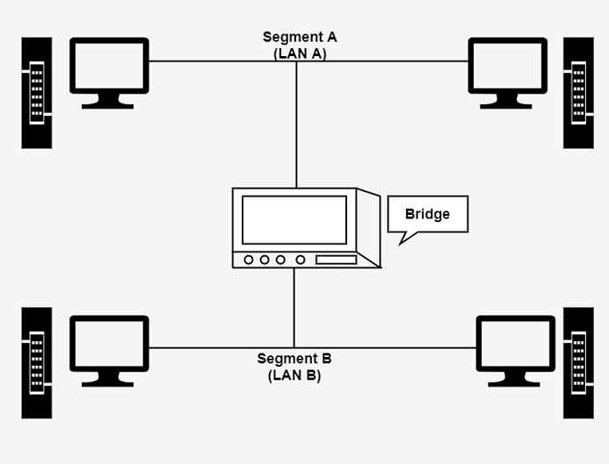

Slide 42
9. Gateway
A gateway is a network component that acts as a gate between the two different networks.
It may be a router, firewall, server or other device that enables traffic to flow in and out of the network.
Why we use gateway device in a network?
Router can communicate between two different networks using the same protocal.
On the other hand a gateway is a network node that connects two networks using different protocols together.

Slide 43
Gateway is also called protocal converter.
It allow us to send and receive data through the internet even it is LAN network.
Gateway operates all 7 layers of OSI model.
We can’t access the internet with out a gateway.
It provide same security.
It is more expensive.
Data transimission rate is slower.
Difficult to maintain as well as very complex.

Slide 44
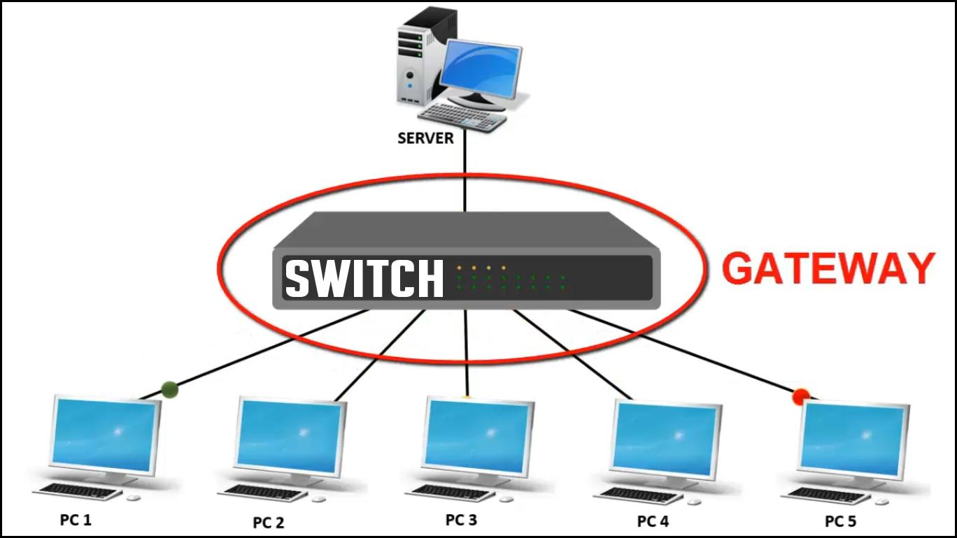
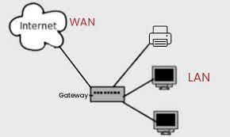
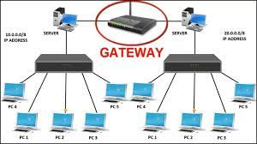

Slide 45
Computer Network Types
A computer network is a group of computers linked to each other that enables the computer to communicate with another computer and share their resources, data, and applications.
A computer network can be categorized by their size. A computer network is mainly of four types:
    LAN(Local Area Network)
    PAN(Personal Area Network)
    MAN(Metropolitan Area Network)
    WAN(Wide Area Network)

Slide 46
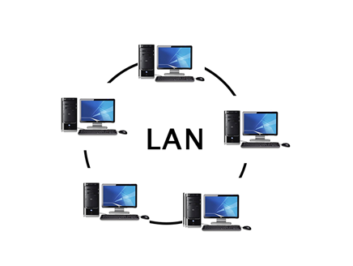
    LAN(Local Area Network)
Local Area Network is a group of computers connected to each other in a small area such as building, office.
LAN is used for connecting two or more personal computers through a communication medium such as twisted pair, coaxial cable, etc.
It is less costly as it is built with inexpensive hardware such as hubs, network adapters, and ethernet cables.
The data is transferred at an extremely faster rate in Local Area Network.
Local Area Network provides higher security.

Slide 47
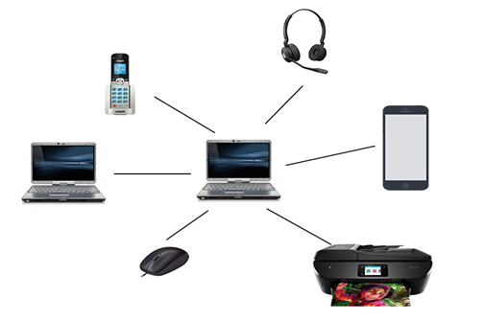
    2. PAN(Personal Area Network)
Personal Area Network is a network arranged within an individual person, typically within a range of 10 meters.
Personal Area Network is used for connecting the computer devices of personal use is known as Personal Area Network.
Personal computer devices that are used to develop the personal area network are the laptop, mobile phones, bluetooth,media player and play stations.

Slide 48
There are two types of Personal Area Network:
Wired Personal Area Network Ex: USB
Wireless Personal Area Network Ex: bluetooth,wifi
    3. MAN(Metropolitan Area Network)
A metropolitan area network is a network that covers a larger geographic area by interconnecting a different LAN to form a larger network.
Government agencies use MAN to connect to the citizens and private industries.
In MAN, various LANs are connected to each other through a telephone exchange line.
It has a higher range than Local Area Network(LAN).

Slide 49
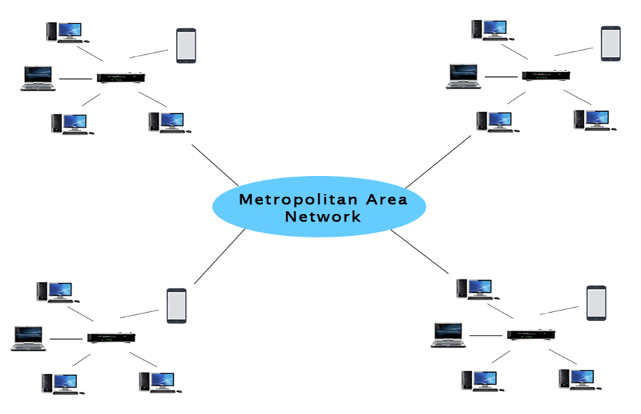
Uses Of Metropolitan Area Network:
MAN is used in communication between the banks in a city.
It can be used in an Airline Reservation.
It can be used in a college within a city.
It can also be used for communication in the military.

Slide 50
    4. WAN(Wide Area Network)
A Wide Area Network is a network that extends over a large geographical area such as states or countries.
A Wide Area Network is quite bigger network than the LAN.
A Wide Area Network is not limited to a single location, but it spans over a large geographical area through a telephone line, fibre optic cable or satellite links.
The internet is one of the biggest WAN in the world.
A Wide Area Network is widely used in the field of Business, government, and education.

Slide 51
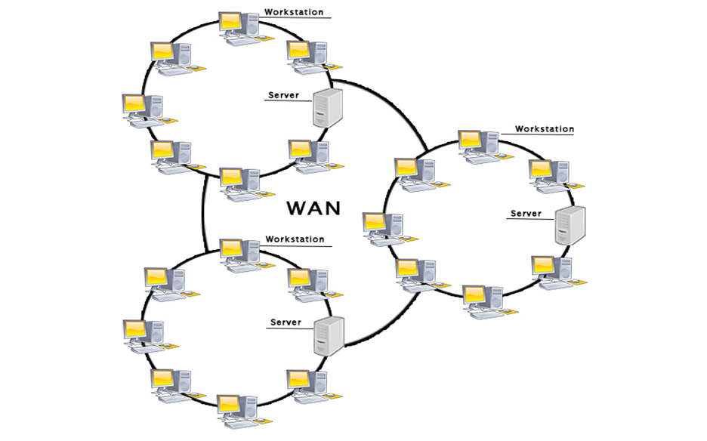

Slide 52
Examples Of Wide Area Network:
Mobile Broadband: A 4G network is widely used across a region or country.
Last mile: A telecom company is used to provide the internet services to the customers in hundreds of cities by connecting their home with fiber.
Advantages Of Wide Area Network
Global business: We can do the business over the internet globally.
High bandwidth: If we use the leased lines for our company then this gives the high bandwidth. The high bandwidth increases the data transfer rate which in turn increases the productivity of our company.

Slide 53
Centralized data: In case of WAN network, data is centralized. Therefore, we do not need to buy the emails, files or back up servers.
Get updated files: Software companies work on the live server. Therefore, the programmers get the updated files within seconds.
Exchange messages: In a WAN network, messages are transmitted fast. The web application like Facebook, Whatsapp, Skype allows you to communicate with friends.

Slide 54
Disadvantages of Wide Area Network
Security issue: A WAN network has more security issues as compared to LAN and MAN network as all the technologies are combined together that creates the security problem.
Needs Firewall & antivirus software: The data is transferred on the internet which can be changed or hacked by the hackers, so the firewall needs to be used. Some people can inject the virus in our system so antivirus is needed to protect from such a virus.
High Setup cost: An installation cost of the WAN network is high as it involves the purchasing of routers, switches.
Troubleshooting problems: It covers a large area so fixing the problem is difficult.

Slide 55
Network Topology
Topology defines the structure of the network of how all the components are interconnected to each other. There are two types of topology: physical and logical topology.
Physical topology is the geometric representation of all the nodes in a network.
Types of Network topology
Bus Topology
Ring Topology
Star Topology
Mesh Topology
Tree Topology
Hybrid Topology

Slide 56
Bus Topology
A bus topology (or) a line topology is a network setup in which each computer and network device are connected to a single cable or backbone cable.
Each node is either connected to the backbone cable by drop cable or directly connected to the backbone cable.
When a node wants to send a message over the network, it puts a message over the network. All the stations available in the network will receive the message whether it has been addressed or not.

Slide 57
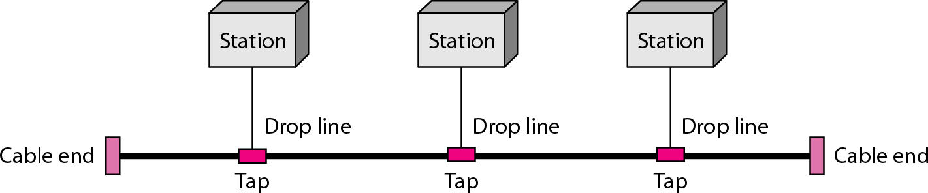
Advantages of bus topology
It works well when you have a small network.
It's the easiest network topology for connecting computers or peripherals in a linear fashion.
It requires less cable length than a star topology.

Slide 58
Disadvantages of bus topology
It can be difficult to identify the problems if the
whole network goes down.
It can be hard to troubleshoot individual device issues.
Bus topology is not great for large networks.
Terminators are required for both ends of the main cable.
Additional devices slow the network down.
If a main cable is damaged, the network fails .

Slide 59
2. Ring Topology
Ring topology is like a bus topology, but with connected ends.
The node that receives the message from the previous computer will retransmit to the next node.
The data flows in a single loop continuously known as an endless loop.
It has no terminated ends, i.e., each node is connected to other node and having no termination point.

Slide 60
The data in a ring topology flow in a clockwise direction.
Ring topologies may be used in either local area networks (LANs) or wide area networks (WANs).
The data flows in one direction, i.e.., it is unidirectional, but it can be made bidirectional by having 2 connections between each Network Node, it is called Dual Ring Topology. In-Ring Topology, the Token Ring Passing protocol is used by the workstations to transmit the data.

Slide 61
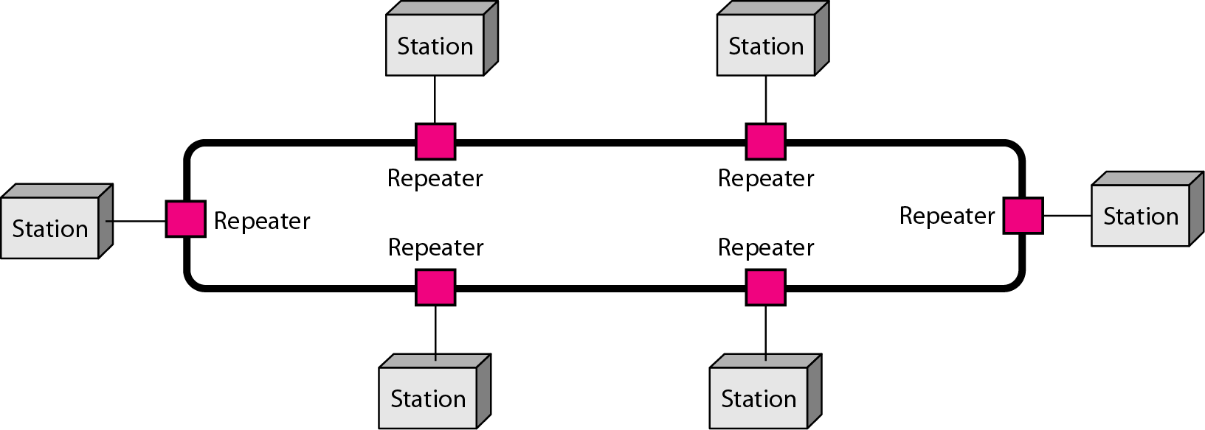
A number of repeaters are used for Ring topology with a large number of nodes, because if someone wants to send some data to the last node in the ring topology with 100 nodes, then the data will have to pass through 99 nodes to reach the 100th node. Hence to prevent data loss repeaters are used in the network.

Slide 62
The most common access method of ring topology is token passing.
    Token passing : It is network access method in which token is passed from one node to another node.
    Token : It is a frame that circulates around network.
Working of Token p
A token moves around the network, and it is passed from computer to computer until it reaches the destination.
The sender modifies the token by putting the address along with the data.
The data is passed from one device to another device until the destination address matches. Once the token received by the destination device, then it sends the acknowledgment to the sender.
In a ring topology, a token is used as a carrier.assing

Slide 63
Advantages of Ring topology:
The data transmission is high-speed.
The possibility of collision is minimum in this type of topology.
Cheap to install and expand.
It is less costly than a star topology.
Disadvantages of Ring topology
The failure of a single node in the network can cause the entire network to fail.
Troubleshooting is difficult in this topology.
The addition of stations in between or removal of stations can disturb the whole topology.
Less secure.

Slide 64
3. Star Topology
Star topology is an arrangement of the network in which every node is connected to the central hub, switch or a central computer.
The central computer is known as a server, and the peripheral devices attached to the server are known as clients.
Coaxial cable or RJ-45 cables are used to connect the computers.

Slide 65
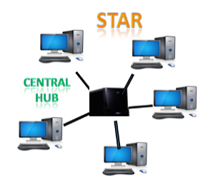
Hubs or Switches are mainly used as connection devices in a physical star topology.
Star topology is the most popular topology in network implementation.

Slide 66
Advantages of Star topology
Efficient troubleshooting: Troubleshooting is quite efficient in a star topology. In a star topology, all the stations are connected to the centralized network. Therefore, the network administrator has to go to the single station to troubleshoot the problem.
Easy to add another computer to the network.
If one computer on the network fails, the rest of the network continues to function normally.
The star topology is used in local-area networks (LANs), High-speed LANs often use a star topology with a central hub.

Slide 67
Disadvantages of Star topology
A Central point of failure: If the central hub or switch goes down, then all the connected nodes will not be able to communicate with each other.
The cost of installation is high.
Performance is based on the hub(central device) that’s it depends on its capacity.

Slide 68
4. Mesh Topology
Mesh technology is an arrangement of the network in which computers are interconnected with each other through various redundant(extra) connections.
There are multiple paths from one computer to another computer.
It does not contain the switch, hub or any central computer which acts as a central point of communication.
The Internet is an example of the mesh topology.

Slide 69
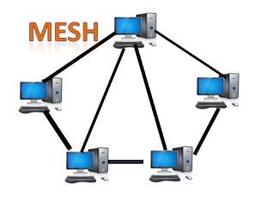
Mesh topology is mainly used for WAN implementations where communication failures are a critical concern.
Mesh topology is mainly used for wireless networks.
Mesh topology can be formed by using the formula:
Number of cables = (n*(n-1))/2;
Where n is the number of nodes that represents the network.

Slide 70
Mesh topology is divided into two categories:
Full Mesh Topology: In a full mesh topology, each computer is connected to all the computers available in the network.
Partial Mesh Topology: In a partial mesh topology, not all but certain computers are connected to those computers with which they communicate frequently.
Advantages of Mesh topology:
Reliable: The mesh topology networks are very reliable as if any link breakdown will not affect the communication between connected computers.
Fast Communication: Communication is very fast between the nodes.
Easier Reconfiguration: Adding new devices would not disrupt the communication between other devices.

Slide 71
Disadvantages of Mesh topology
Cost: A mesh topology contains a large number of connected devices such as a router and more transmission media than other topologies. So, cost is more.
Management: Mesh topology networks are very large and very difficult to maintain and manage. If the network is not monitored carefully, then the communication link failure goes undetected.
Efficiency: In this topology, redundant connections are high that reduces the efficiency of the network.

Slide 72
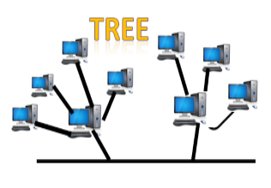
5. Tree Topology
Tree topology combines the characteristics of bus topology and star topology.
A tree topology is a type of structure in which all the computers are connected with each other in hierarchical fashion.
The top-most node in tree topology is known as a root node, and all other nodes are the descendants of the root node.
There is only one path exists between two nodes for the data transmission. Thus, it forms a parent-child hierarchy.

Slide 73
Advantages of Tree topology
Support for broadband transmission: Tree topology is mainly used to provide broadband transmission, i.e., signals are sent over long distances without being attenuated.
Easily expandable: We can add the new device to the existing network. Therefore, we can say that tree topology is easily expandable.
Easily manageable: In tree topology, the whole network is divided into segments known as star networks which can be easily managed and maintained.
Error detection: Error detection and error correction are very easy in a tree topology.
Limited failure: The breakdown in one station does not affect the entire network.

Slide 74
Disadvantages of Tree topology
Difficult troubleshooting: If any fault occurs in the node, then it becomes difficult to troubleshoot the problem.
High cost: Devices required for broadband transmission are very costly.
Failure: A tree topology mainly relies on main bus cable and failure in main bus cable will damage the overall network.
Reconfiguration difficult: If new devices are added, then it becomes difficult to reconfigure.

Slide 75
6. Hybrid Topology
The combination of various different topologies is known as Hybrid topology.
A Hybrid topology is a connection between different links and nodes to transfer the data.
When two or more different topologies are combined together is termed as Hybrid topology and if similar topologies are connected with each other will not result in Hybrid topology. For example, if there exist a ring topology in one branch of ICICI bank and bus topology in another branch of ICICI bank, connecting these two topologies will result in Hybrid topology.

Slide 76
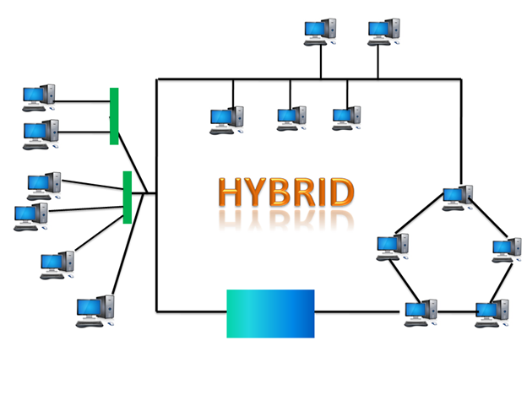

Slide 77
Advantages of Hybrid Topology
Reliable: If a fault occurs in any part of the network will not affect the functioning of the rest of the network.
Scalable: Size of the network can be easily expanded by adding new devices without affecting the functionality of the existing network.
Flexible: This topology is very flexible as it can be designed according to the requirements of the organization.
Effective: Hybrid topology is very effective as it can be designed in such a way that the strength of the network is maximized and weakness of the network is minimized.

Slide 78
Disadvantages of Hybrid topology
Complex design: The major drawback of the Hybrid topology is the design of the Hybrid network. It is very difficult to design the architecture of the Hybrid network.
Costly Hub: The Hubs used in the Hybrid topology are very expensive as these hubs are different from usual Hubs used in other topologies.
Costly infrastructure: The infrastructure cost is very high as a hybrid network requires a lot of cabling, network devices, etc.

Slide 79
NETWORK SOFTWARE
Network software is a set of tools (or) set of rules/protocols that helps computers to share information with each other or allows users to share computer programs.so, now a network software is a highly structured.
Some of the basic network software components used in a computer network are described below:
    Protocol Hierarchies (layer structure)
    Design Issues for the Layers
    Connection-Oriented and Connectionless Services
    Service Primitives
    The Relationship of Services to Protocols

Slide 80
Protocol Hierarchies (layer structure)
A list of protocols used by a certain system, one protocol per layer is called a protocol stack.
A set of layers and protocols is called a network architecture.
Most networks are organized as a stack of layers, one layer on the top of another layer. The number of layers and their names vary from network to network. Each layer has a specified function and protocols. Thus we obtain a stack of protocols.
The main purpose of each of layers is just to offer and provide services to higher layers that are present. Each and every layer has some particular task or function.
The networks are orga
nized and arranged as different layers or levels simply to reduce and minimize complexity of design of network software.

Slide 81
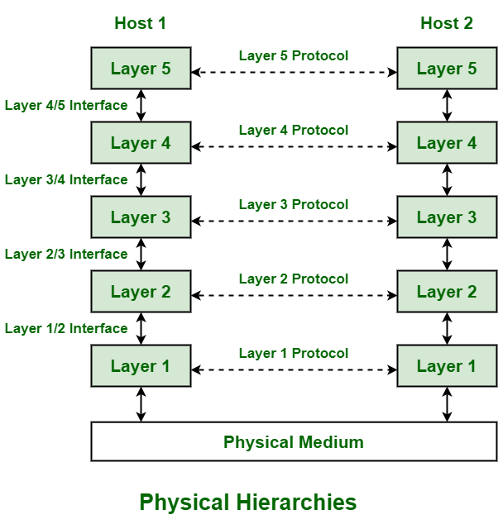
Example:

Slide 82
The diagram shows communication between Host 1 and Host 2. The data stream is passed through a number of layers from one host to other.
Virtual communication is represented using dotted lines between peer layers.
Physical communication is represented using solid arrows between adjacent layers. Through physical medium, actual communication occurs.
The layers at same level are commonly known as peers. The peer basically has a set of communication protocols. An interface is present between each of layers that are used to explain services provided by lower layer to higher layer.

Slide 83
Design Issues for the Layers
A number of design issues exist for the layer to layer approach of computer networks. Some of the main design issues are as follows −
    Reliability
  Network channels and components may be unreliable, resulting in loss of bits while data transfer. So, an important design issue is to make sure that the information transferred is not distorted.
    b) Addressing: At a particular time, innumerable messages are being transferred between large numbers of computers. So, a naming or addressing system should exist so that each layer can identify the sender and receivers of each message.

Slide 84
C) Data Transfer
we can transfer the data in simplex mode, half duplex mode and full duplex mode.
d) Routing
There may be multiple paths from the source to the destination. Routing involves choosing an optimal path among all possible paths, in terms of cost and time. There are several routing algorithms that are used in network systems.

Slide 85
  e) Error Control
Unreliable channels introduce a number of errors in the data streams that are communicated. So, the layers need to agree upon common error detection and error correction methods so as to protect data packets while they are transferred.
f)Security
A major factor of data communication is to defend it against threats .So, there should be adequate mechanisms to prevent unauthorized access to data through authentication and cryptography.

Slide 86
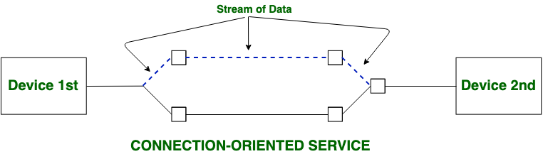
3. Connection-Oriented and Connectionless Services
Both Connection-oriented service and Connection-less service are used for the connection establishment between two or more two devices. These types of services are offered by the network layer.
Connection-oriented service:
it is related to the telephone system. It includes connection establishment and connection termination. In a connection-oriented service, the Handshake method is used to establish the connection between sender and receiver. Ex: Email, TCP

Slide 87
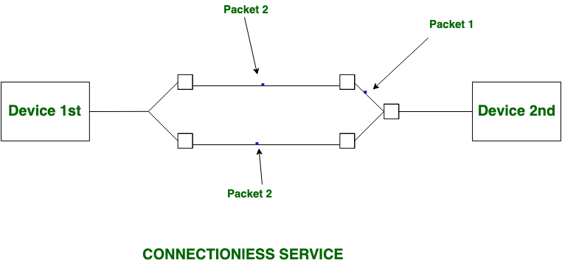
b) Connection-less service:
It is related to the postal system.
It does not include any connection establishment and connection termination.
Connection-less Service does not give a guarantee of reliability.
In this, Packets do not follow the same path to reach their destination. Ex : Video streaming, UDP

Slide 88
Difference between Connection-oriented and Connection-less Services:
S.NO | Connection-oriented Service | Connection-less Service
1. | Connection-oriented service is related to the telephone system. | Connection-less service is related to the postal system.
2. | Connection-oriented service is preferred by long and steady communication. | Connection-less Service is preferred by bursty communication.
3. | Connection-oriented Service is necessary. | Connection-less Service is not compulsory.
4. | Connection-oriented Service is feasible. | Connection-less Service is not feasible.
5. | In connection-oriented Service, Congestion is not possible. | In connection-less Service, Congestion is possible.

Slide 89
6. | Connection-oriented Service gives the guarantee of reliability. | Connection-less Service does not give a guarantee of reliability.
7. | In connection-oriented Service, Packets follow the same route. | In connection-less Service, Packets do not follow the same route.
8. | Connection-oriented services require a bandwidth of a high range. | Connection-less Service requires a bandwidth of low range.
9. | Ex: TCP (Transmission Control Protocol) | Ex: UDP (User Datagram Protocol)
10. | Connection-oriented requires authentication. | Connection-less Service does not require authentication.

Slide 90
4. Service Primitives(operations) of network software
A Service is a set of primitives. A primitive simply means Operations.
The selective primitives tell the service to perform an action taken by peer nodes.
The initiating node wants to establish a connection send CONNECT.
  Request − A node wants to do some work or a packet is being sent.
The receiver accepts the request and CONNECT.
  Indication − A node is saying that it wants to set up a connection to it.

Slide 91
The CONNECT. The node issuing the initial CONNECT. request finds out what happened via a CONNECT. Confirm primitive.
Response is primitive to tell whether it wants to accept or reject the proposed connection.
These primitives can be used for a request-response interaction in a client-server environment.

Slide 92
Classification of Service Primitives :
Primitive | Meaning
Request | It represent entity that wants or request service to perform some action or do some work (requesting for connection to remote computer).
Indication | It represent entity that is to be informed about event (receiver just have received request of connection).
Response | It represents entity that is responding to event (receiver is simply sending the permission or allowing to connect).
Confirm | It represent entity that acknowledges the response to earlier request that has come back (sender just acknowledge the permission to get connected to the remote host).

Slide 93
Primitives of Connection-Oriented Service :
Primitive | Meaning
Listen | When server is ready to accept request of incoming connection, it simply put this primitive into action. Listen primitive simply waiting for incoming connection request.
Connect | This primitive is used to connect the server simply by creating or establishing connection with waiting peer.
Accept | This primitive simply accepts incoming connection form peer.
Receive | These primitive afterwards block the server. Receive primitive simply waits for incoming message.
Send | This primitive is put into action by the client to transmit its request that is followed by putting receive primitive into action to get the reply. Send primitive simply sends or transfer the message to the peer.
Disconnect | This primitive is simply used to terminate or end the connection after which no one will be able to send any of the message.

Slide 94
Primitives of Connectionless Service :
Primitive | Meaning
Unitdata | Unitdata primitive is simply required to send packet of data or information.
Facility, Report | This primitive is required for getting details about the performance and working of the network such as delivery statistics or report.

Slide 95
5. The Relationship of Services to Protocols
Service:
Service is a set of primitives (operations) that a layer provides to the layer above it.
service relate to the interfaces between layers.
Protocol:
Protocol is a set of rules governing the format and meaning of packets exchanged by peer entities within a layer.
protocols relate to the packets sent between peer entities on different machines.

Slide 96
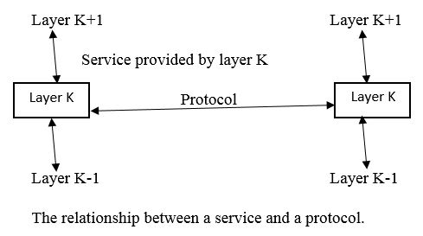

Slide 97
Reference Models
The OSI Reference Model
OSI stands for Open Systems Interconnection. It has been developed by ISO – ‘International Organization for Standardization‘, in the year 1984.
It is a 7 layer architecture with each layer having specific functionality to perform. All these 7 layers work collaboratively (together)
to transmit the data from one person to another across the globe.

Slide 98
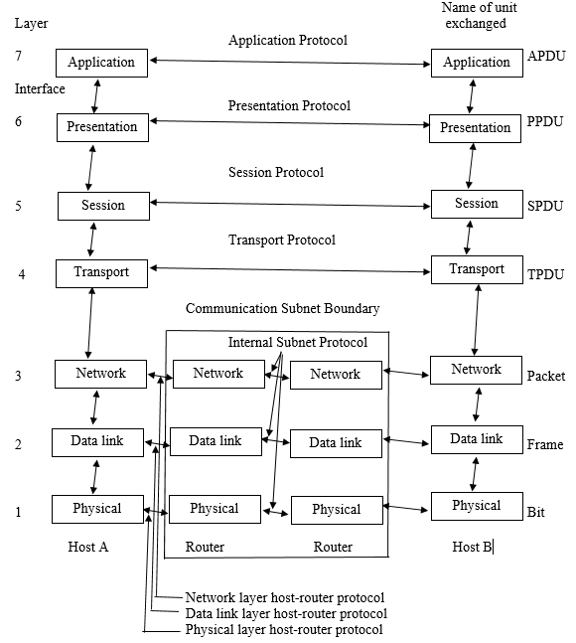

Slide 99
1. Physical Layer (Layer 1) :
The lowest layer of the OSI reference model is the physical layer. It is responsible for the actual physical connection between the devices.
The physical layer contains information in the form of bits. It is responsible for transmitting individual bits from one node to the next. When receiving data, this layer will get the signal received and convert it into 0s and 1s and send them to the Data Link layer, which will put the frame back together.
Hub, Repeater, Modem, Cables are Physical Layer devices.
Network Layer, Data Link Layer, and Physical Layer are also known as Lower Layers or Hardware Layers.

Slide 100
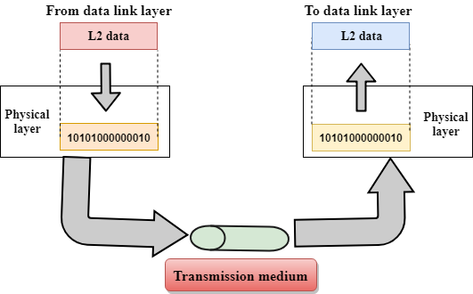

Slide 101
The functions of the physical layer are as follows:
Bit synchronization: The physical layer provides the synchronization of the bits by providing a clock. This clock controls both sender and receiver thus providing synchronization at bit level.
Bit rate control: The Physical layer also defines the transmission rate i.e. the number of bits sent per second.
Physical topologies: Physical layer specifies the way in which the different, devices/nodes are arranged in a network i.e. bus, star, or mesh topology.
Transmission mode: Physical layer also defines the way in which the data flows between the two connected devices. The various transmission modes possible are Simplex, half-duplex and full-duplex.

Slide 102
2. Data Link Layer (DLL) (Layer 2) :
This layer is responsible for the error-free transfer of data frames, over the physical layer.
When a packet arrives in a network, it is the responsibility
of DLL to transmit it to the Host using its MAC address.
Packet in Data Link layer is referred to as Frame.
Data Link layer is handled by the NIC and device drivers of host machines.
Switch & Bridge are Data Link Layer devices.
Data Link Layer is divided into two sublayers:
Logical Link Control (LLC)
Media Access Control (MAC)

Slide 103
a. Logical Link Control (LLC)Layer
  It is responsible for transferring the packets to the Network layer of the receiver that is receiving.
  It identifies the address of the network layer protocol from the header.
  It also provides data flow control.
b. Media Access Control(MAC) Layer
  A Media access control layer is a link between the Logical Link Control layer and the network's physical layer.
  It is used for transferring the packets over the network.

Slide 104
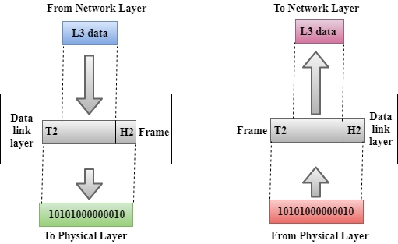

Slide 105

Functions of the Data-link layer
Framing: The data link layer translates the physical's raw bit stream into packets known as Frames. The Data link layer adds the header and trailer to the frame. The header which is added to the frame contains the node destination and source address.
Physical Addressing: After creating frames, the Data link layer adds physical addresses (MAC address) of the sender and/or receiver in the header of each frame.

Slide 106
Flow Control:
  Flow control is the main functionality of the Data-link layer.
  The data rate must be constant on both sides else the data may get corrupted thus, flow control coordinates the amount of data that can be sent before receiving acknowledgement.
Access Control:
  When two or more devices are connected to the same communication channel, then the data link layer protocols(MAC layer protocol) are used to determine which device has control over the link at a given time.

Slide 107
Error Control:
  Data link layer provides the mechanism of error control in which it detects and retransmits damaged or lost frames.
  Error control is achieved by adding a calculated value CRC (Cyclic Redundancy Check) that is placed to the Data link layer's trailer which is added to the message frame before it is sent to the physical layer.
  If any error seems to occur, then the receiver sends the acknowledgment for the retransmission of the corrupted frames.

Slide 108
3. Network Layer (Layer 3) :
The network layer works for the transmission of data from one host to the other located in different networks.
It manages device addressing, tracks the location of devices on the network.
It determines the best path to move data from source to the destination based on the network conditions, the priority of service, and other factors.
The network layer is responsible for routing and forwarding the packets.
Routers are the layer 3 devices, they are specified in this layer and used to provide the routing services within an internetwork.
The protocols used to route the network traffic are known as Network layer protocols. Examples of protocols are IP and Ipv6.

Slide 109
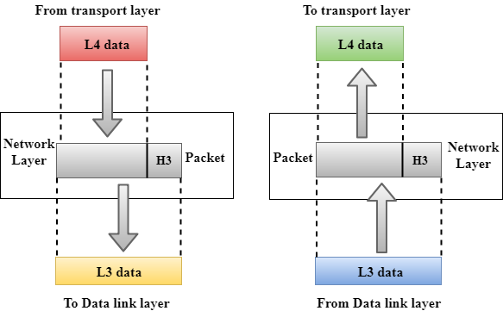
Network layer is implemented by networking
devices such as routers.
Data Segments in Network layer is referred to as Packet.

Slide 110
Functions of Network Layer:
Routing: Routing is the major component of the network layer, and it determines the best optimal path out of the multiple paths from source to the destination.
Logical Addressing: In order to identify each device on internetwork uniquely, the network layer defines an addressing scheme. The sender & receiver’s IP addresses are placed in the header by the network layer. Such an address distinguishes each device uniquely and universally.

Slide 111
4. Transport Layer (Layer 4) :
  The transport layer provides services to the application layer and takes services from the network layer.
  The data in the transport layer is referred to as Segments.
  It is responsible for the End to End Delivery of the complete message.
  The transport layer also provides the acknowledgement of the successful data transmission and re-transmits the data if an error is found.
  Transport layer is operated by the Operating System. It is a part of the OS and communicates with the Application Layer by making system calls.
  Transport Layer is called as Heart of OSI model.

Slide 112
The services or protocols provided by the transport layer :
A. Connection-Oriented Service: It is a three-phase process that includes
    – Connection Establishment
    – Data Transfer
    – Termination / disconnection
    In this type of transmission, the receiving device sends an acknowledgement, back to the source after a packet or group of packets is received.
    This type of transmission is reliable and secure.
    Example: TCP(Transmission Control Protocol)

Slide 113
B. Connectionless service:
It is a one-phase process and includes Data Transfer.
In this type of transmission, receiver does not send any acknowledgment when the packet is received, the sender does not wait for any acknowledgment. Therefore, this makes a protocol unreliable.
Connection-oriented service is more reliable than connectionless Service.
Example: User Datagram Protocol (UDP) is a transport layer protocol.

Slide 114
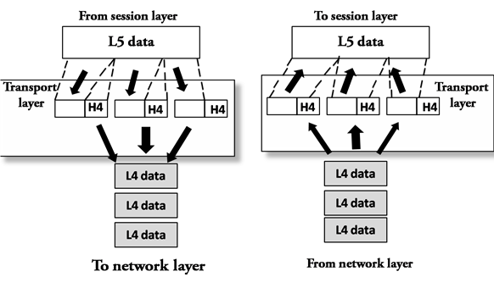

Slide 115
Functions of Transport Layer:
Segmentation and reassembly:
When the transport layer receives the message from the upper layer(session layer), it divides the message into multiple segments, and each segment is assigned with a sequence number that uniquely identifies each segment.
When the message has arrived at the destination, then the transport layer reassembles the message based on their sequence numbers.
Service Point Addressing:
In order to deliver the message to the correct process, the transport layer header contains a type of address called service point address or port address. Thus by specifying this address, the transport layer makes sure that the message is delivered to the correct process(computer).

Slide 116
5. Session Layer (Layer 5) :
This layer is responsible for the establishment of connection, maintainance of sessions, authentication, and also ensures security.
All the below 3 layers(including Session Layer) are integrated as a single layer in the TCP/IP model as “Application Layer”.
Implementation of these 3 layers is done by the network application itself. These are also known as Upper Layers or Software Layers.

Slide 117
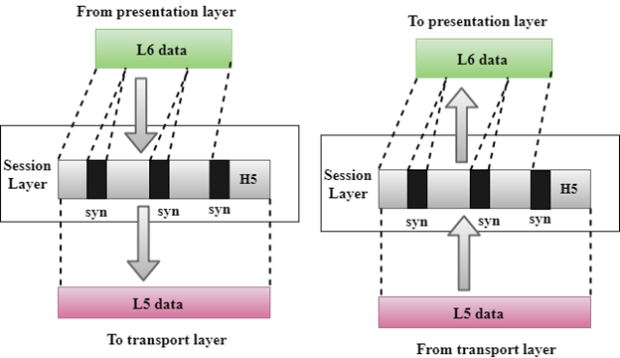

Slide 118
Functions of Session layer:
Session establishment, maintenance, and termination: The layer allows the two processes to establish, use and terminate a connection.
Dialog Controller: The session layer allows two systems to start communication with each other in half-duplex or full-duplex.
Synchronization: Session layer adds some checkpoints when transmitting the data in a sequence. If some error occurs in the middle of the transmission of data, then the transmission will take place again from the checkpoint. This process is known as Synchronization and recovery.

Slide 119
6. Presentation Layer (Layer 6):
  The presentation layer is also called the Translation layer.
  The data from the application layer is extracted here and manipulated as per the required format to transmit over the network.
  The functions of the presentation layer are :
    Translation: For example, ASCII to EBCDIC.
    Encryption/ Decryption: Data encryption translates the data into another form or code. The encrypted data is known as the ciphertext and the decrypted data is known as plain text. A key value is used for encrypting as well as decrypting data.
    Compression: Reduces the number of bits that need to be transmitted on the network.

Slide 120
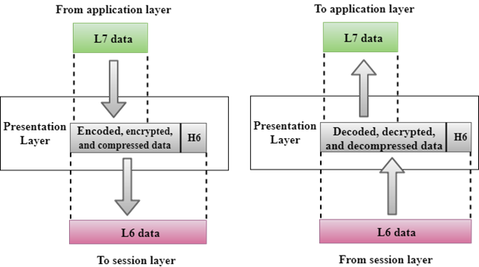

Slide 121
7. Application Layer (Layer 7) :
It is a very top of the OSI Reference Model in the stack of layers, we find the Application layer which is implemented by the network applications.
These applications produce the data, which has to be transferred over the network.
This layer also serves as a window for the application services to access the network and for displaying the received information to the user.
Example: Application – Browsers, Skype Messenger, etc.
Application Layer is also called Desktop Layer

Slide 122
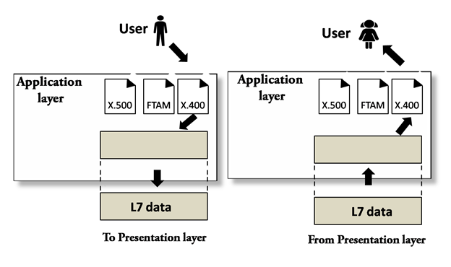

Slide 123
The functions of the Application layer are :
File transfer, access, and management (FTAM):
  An application layer allows a user to access the files in a remote computer, to retrieve the files from a computer and to manage the files in a remote computer.
Mail services:
An application layer provides the facility for email forwarding and storage.
OSI model acts as a reference model and is not implemented on the Internet because of its late invention. The current model being used is the TCP/IP model.

Slide 124
TCP/IP Model (Transmission Control Protocol/Internet Protocol)
TCP/IP means Transmission Control Protocol and Internet Protocol.
It is the network model used in the current Internet architecture
It was developed by the DoD (Department of Defence) in the 1960s.
Function of TCP is Collecting and Reassembling Data Packets.
Function of IP is Sending the Data Packets to the correct destination.
The overall idea was to allow one application on one computer to talk to(send data packets to) another application running on different computer.

Slide 125
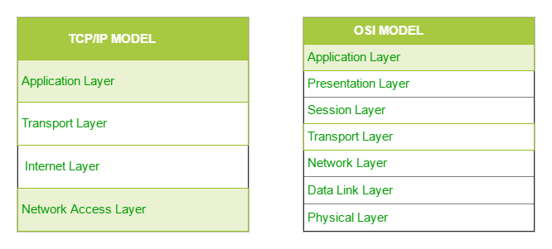
The TCP/IP model is structured with four different layers. These four layers are:
        Network Access Layer/link layer
        Internet Layer
        Host to Host Layer/Transport layer
        Application Layer/process layer

Slide 126
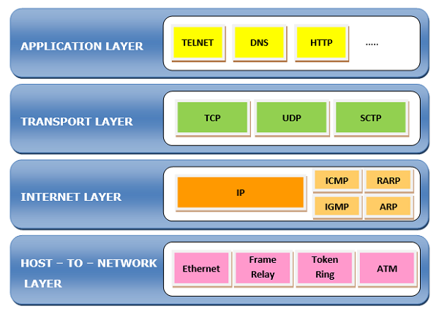
Fig: diagram of Sender side TCP/IP

Slide 127
        Network Access Layer/link layer(Layer 1)
        The first layer is the Process layer/application layer on the behalf of the sender and Network Access layer on the behalf of the receiver.
A network layer is the lowest layer of the TCP/IP model.
A network layer is the combination of the Physical layer and Data Link layer defined in the OSI reference model.
It defines how the data should be sent physically through the network.
This layer is mainly responsible for the transmission of the data between two devices on the same network.

Slide 128
The functions carried out by this layer are encapsulating the IP datagram into frames transmitted by the network and mapping of IP addresses into physical addresses(MAC address).
The protocols used by this layer are ethernet, token ring, frame relay..etc.

Slide 129
2. Internet Layer(Layer 2)
An internet layer is the second layer of the TCP/IP model.
An internet layer is also known as the network layer.
It defines the protocols which are responsible for logical transmission of data over the entire network.
Following are the protocols used in this layer are:
I. IP Protocol: IP protocol is used in this layer, and it is the most significant part of the entire TCP/IP suite.
Following are the responsibilities of this protocol:
IP Addressing: This protocol implements logical host addresses known as IP addresses. The IP addresses are used by the internet and higher layers to identify the device and to provide internetwork routing.

Slide 130
Host-to-host communication: It determines the path through which the data is to be transmitted.
Data Encapsulation and Formatting: An IP protocol accepts the data from the transport layer protocol. An IP protocol ensures that the data is sent and received securely, it encapsulates the data into message known as IP datagram.
II. ARP Protocol
ARP stands for Address Resolution Protocol.
ARP is a network layer protocol which is used to find the physical address from the IP address.

Slide 131
III. ICMP Protocol
ICMP stands for Internet Control Message Protocol.
It is a mechanism used by the hosts or routers to send notifications regarding datagram problems back to the sender.
A datagram travels from router-to-router until it reaches its destination. If a router is unable to route the data because of some unusual conditions such as disabled links, a device is on fire or network congestion, then the ICMP protocol is used to inform the sender that the datagram is undeliverable.

Slide 132
3. Host to Host Layer/Transport layer
It is responsible for end-to-end communication and error-free delivery of data.
The two protocols used in the transport layer are User Datagram protocol and Transmission control protocol.
User Datagram Protocol (UDP)
  It provides connectionless service and end-to-end delivery of transmission.
  It is an unreliable protocol as it discovers the errors but not specify the error.
  User Datagram Protocol discovers the error, and ICMP protocol reports the error to the sender that user datagram has been damaged.

Slide 133
  UDP is good protocol for data flowing in one direction(means it doesn’t send a acknowledgement to the sender).
  UDP does not guarantee ordered delivery of data.
UDP is suitable protocol for streaming applications such as multimedia streaming.
II. Transmission Control Protocol (TCP)
  It provides a full transport layer services to applications.
  It creates a virtual circuit between the sender and receiver, and it is active for the duration of the transmission.

Slide 134
  TCP is a reliable protocol as it detects the error and retransmits the damaged frames. Therefore, it ensures all the segments must be received and acknowledged before the transmission is considered to be completed and a virtual circuit is discarded.
  At the sending end, TCP divides the whole message into smaller units known as segment, and each segment contains a sequence number which is required for reordering the frames to form an original message.
  At the receiving end, TCP collects all the segments and reorders them based on sequence numbers.

Slide 135
    4. Application Layer/process layer
Three layers of the OSI Model: Application, Presentation and Sessions, when combined together, they perform similar functions as the Application Layer of the TCP/IP model.
An application layer is the topmost layer in the TCP/IP model.
It is responsible for handling high-level protocols, issues of representation.
This layer allows the user to interact with the application.
When one application layer protocol wants to communicate with another application layer, it forwards its data to the transport layer.

Slide 136
There is an ambiguity occurs in the application layer. Every application cannot be placed inside the application layer except those who interact with the communication system.
For example: text editor cannot be considered in application layer while web browser using HTTP protocol to interact with the network where HTTP protocol is an application layer protocol.
Following are the main protocols used in the application layer:
    HTTP: HTTP stands for Hypertext transfer protocol. This protocol allows us to access the data over the world wide web. It transfers the data in the form of plain text, audio, video.

Slide 137
SMTP: SMTP stands for Simple mail transfer protocol. The TCP/IP protocol that supports the e-mail is known as a Simple mail transfer protocol. This protocol is used to send the data to another e-mail address.
DNS: DNS stands for Domain Name System. An IP address is used to identify the connection of a host to the internet uniquely. But, people prefer to use the names instead of addresses. Therefore, the system that maps the name to the address is known as Domain Name System.
FTP: FTP stands for File Transfer Protocol. FTP is a standard internet protocol used for transmitting the files from one computer to another computer.

Slide 138
TELNET: It is an abbreviation for Terminal Network. It establishes the connection between the local computer and remote computer in such a way that the local terminal appears to be a terminal at the remote system.
SNMP: SNMP stands for Simple Network Management Protocol. It is a framework used for managing the devices on the internet by using the TCP/IP protocol suite.

Slide 139
EXAMPLES OF NETWORKS
ARPANET:
ARPANET stands for Advanced Research Projects Agency NET.
It was first to implement TCP/IP protocols. It was basically beginning of Internet with use of these technologies.
It was designed with a basic idea in mind that was to communicate with scientific users among an institute or university.
ARPANET used the packet-switching technology to interconnect four nodes. Hence DoD divided the network into subnets & host computers. Subnet would consist of minicomputers called “Interface Message Processors” (IMPs) connected by transmission lines. For high reliability, each IMP would be connected to atleast 2 IMPs.

Slide 140
ARPANET was introduced in the year 1969 by Advanced Research Projects Agency (ARPA) of US Department of Defense.
In the 1970s, ARPANET initially connected only a few sites in several metropolitan areas of Boston, San Francisco, and Los Angeles. Then ARPANET gradually developed into a highly de-urbanized and decentralized communications network, connecting remote centers and military bases in the United States.
Characteristics of ARPANET :
  It is basically a type of WAN.
  It used concept of Packet Switching Network.
  It used Interface Message Processors(IMPs) for sub-netting.
  ARPANETs software was split into two parts- a host and a subnet.

Slide 141
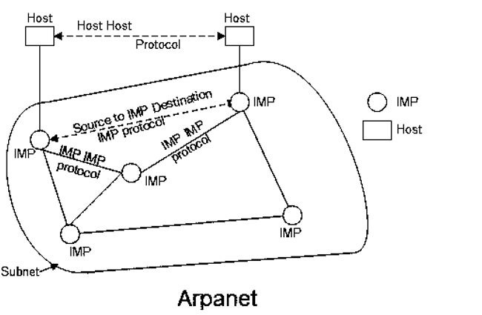

Slide 142
Advantages of ARPANET :
  ARPANET allowed remote login.
  Transfer of files becomes a part of FTP.
  It uses host-to-host protocol called as NCP (network control protocol)
  It uses packet switching to send data.
Disadvantages
  Connection to non-system network architecture networks was difficult.
  Path between the pairs of nodes has to be redesigned and it has to be stored centrally.

Slide 143
INTERNET
The Internet is the network of networks and the network allows to exchange of data between two or more computers.
The internet is a type of network and called network of networks.
The Internet is a way of transporting information between devices.
Accessible in a variety of ways.
Network protocols are used to transport data.
The internet is a collection of interconnected devices which are spread across the globe.
It is a network of networks that consist of public, private, public, sales, finance, academic, business and government networks.

Slide 144
History of the Internet
Here, are important milestones from the history of the Internet:
In 1982 the Internet Protocol (TCP/IP) was standardized.
In 1990, the World Wide Web introduced.
In 1995, mainstream Search Engine Yahoo was created.
In recent time, the Internet covers a large part of the globe and growing exponentially.

Slide 145
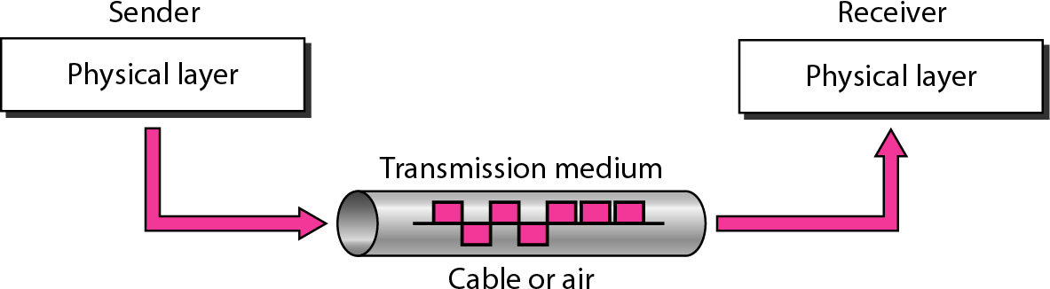
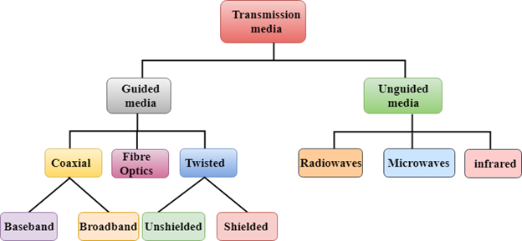
Physical Layer: Guided Transmission media
A transmission medium can be broadly defined as anything that can carry information from a source to a destination.
Classes of transmission media

Slide 146
1. Guided Media
It is defined as the physical medium through which the signals are transmitted. It is also known as Bounded media.
It include Twisted-Pair Cable, Coaxial Cable, and Fibre-Optic Cable.
Signals being transmitted are directed and confined in a narrow pathway by using physical links
Twisted-pair and coaxial cable use metallic (copper) conductors that accept and transport signals in the form of electric current.
Optical fibre is a cable that accepts and transports signals in the form of light.

Slide 147

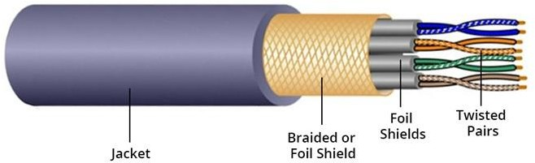
Twisted Pair Cable
It is a type of guided media. It was invented by Alexander Graham Bell. Twisted pair cables have two conductors that are generally made up of copper and each conductor has insulation. These two conductors are twisted together, thus giving the name twisted pair cables.

Slide 148
A twisted pair consists of two conductors(normally copper), each with its own plastic insulators, twisted together. One of these wires is used to carry signals to the receiver, and the other is used only as ground reference. The receiver uses the difference between the two.
The noise or crosstalk in the two parallel conductors is high but this is greatly reduced in twisted pair cables due to the twisting characteristic.

Slide 149
In the first twist, one conductor is near to noise source and the other is far from the source but in the next twist the reverse happens and the resultant noise is very less and hence the balance in signal quality is maintained and the receiver receives very less noise. The quality of signal in twisted pair cables greatly depends upon the number of twists per unit length of the cable.

Slide 150
Twisted Pair Cables are two types :
1. Unshielded Twisted Pair Cables (UTP) :
UTP consists of two insulated copper wires twisted around one another. This type of cable has the ability to block interference and does not depend on a physical shield for this purpose. It is used for telephonic applications.
Advantages Of Unshielded Twisted Pair:
  It is cheap.
  Installation of the unshielded twisted pair is easy.
  It can be used for high-speed LAN.

Slide 151
2. Shielded twisted pair(STP) cable:
This type of cable consists of a special jacket (a copper braid covering or a foil shield) to block external interference and that allows the higher transmission rate.
Advantages Of Shielded Twisted Pair:
  An installation of STP is easy.
  It has higher capacity as compared to unshielded twisted pair cable.
  It is shielded that provides the higher data transmission rate.

Slide 152
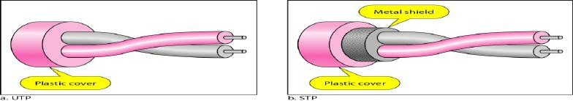
Disadvantage:
  This cable can only be used for shorter distances because of attenuation.

Slide 153
Disadvantages
  Comparatively difficult to install and manufacture
  More expensive
  Bulky

Slide 154
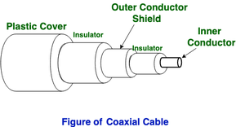
B. Coaxial Cable
Coaxial cable is very commonly used transmission media, for example, TV wire is usually a coaxial cable.
It has a higher frequency as compared to Twisted pair cable.
It has an outer plastic covering containing an insulation layer made of PVC or Teflon and 2 parallel conductors each having a separate insulated protection cover.

Slide 155
Coaxial cable is of two types:
Baseband transmission: It is defined as the process of transmitting a single signal at high speed.
Broadband transmission: It is defined as the process of transmitting multiple signals simultaneously.
Advantages Of Coaxial cable:
  The data can be transmitted at high speed.
  It has better shielding as compared to twisted pair cable.
  It provides higher bandwidth.
Coaxial cable was widely used in analog telephone networks, digital telephone networks.
Cable TV networks also use coaxial cables.
Disadvantages Of Coaxial cable:
  It is more expensive as compared to twisted pair cable.
  Single cable failure can disrupt the entire network

Slide 156
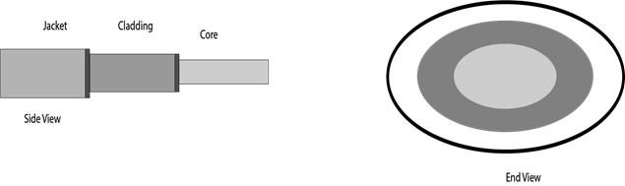
C. Fibre Optic
Fibre optic cable is a cable that uses electrical signals for communication.
Fibre optic is a cable that holds the optical fibres coated in plastic that are used to send the data by pulses of light.
The plastic coating protects the optical fibres from heat, cold, electromagnetic interference from other types of wiring.
Fibre optics provide faster data transmission than copper wires.

Slide 157
Core: The optical fibre consists of a narrow strand of glass or plastic known as a core. A core is a light transmission area of the fibre. The more area of the core, the more light will be transmitted into the fibre.
Cladding: The concentric layer of glass is known as cladding. The main functionality of the cladding is to provide the lower refractive index at the core interface as to cause the reflection within the core so that the light waves are transmitted through the fibre.
Jacket: The protective coating consisting of plastic is known as a jacket. The main purpose of a jacket is to preserve the fibre strength, absorb shock and extra fibre protection.

Slide 158
Advantages of fibre optic cable:
  Greater Bandwidth: The fibre optic cable provides more bandwidth as compared copper. Therefore, the fibre optic carries more data as compared to copper cable.
  Faster speed: Fibre optic cable carries the data in the form of light. This allows the fibre optic cable to carry the signals at a higher speed.
  Longer distances: The fibre optic cable carries the data at a longer distance as compared to copper cable.
  Better reliability: The fibre optic cable is more reliable than the copper cable as it is immune to any temperature changes while it can cause obstruct in the connectivity of copper cable.
Disadvantages:
  Difficult to install and maintain
  High cost

Slide 159
2. UnGuided Transmission
It is also referred to as Wireless or Unbounded transmission media. No physical medium is required for the transmission of electromagnetic signals.
Features:
The signal is broadcasted through air
Less Secure
Used for larger distances
There are 3 types of Signals transmitted through unguided media:

Slide 160
Radio waves
Radio waves are the electromagnetic waves that are transmitted in all the directions of free space.
Radio waves use omnidirectional antennas that send out signals in all directions. Based on the wavelength, strength, and the purpose of transmission.
The range in frequencies of radio waves is from 3Khz to 1 khz.
In the case of radio waves, the sending and receiving antenna are not aligned, i.e., the wave sent by the sending antenna can be received by any receiving antenna.
A Radio wave is useful for multicasting when there is one sender and many receivers.
An FM radio, television, cordless phones are examples of a radio wave.

Slide 161
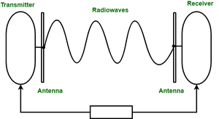
Advantages Of Radio transmission:
Radio transmission is mainly used for wide area networks and mobile cellular phones.
Radio waves cover a large area, and they can penetrate the walls.
Radio transmission provides a higher transmission rate.

Slide 162
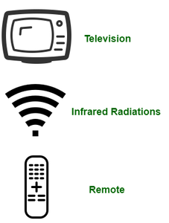
B. Infrared
Infrared waves are used for very short distance communication.
They cannot penetrate through obstacles. This prevents interference between systems.
Frequency Range:300GHz – 400THz.
It is used in TV remotes, wireless mouse, keyboard, printer, etc.

Slide 163
Advantages:
It supports high bandwidth, and hence the data rate will be very high.
Infrared waves cannot penetrate the walls. Therefore, the infrared communication in one room cannot be interrupted by the nearby rooms.
An infrared communication provides better security with minimum interference.
Infrared communication is unreliable outside the building because the sun rays will interfere with the infrared waves.

Slide 164
C. Microwaves:
It is a line of sight transmission i.e. the sending and receiving antennas need to be properly aligned with each other.
The distance covered by the signal is directly proportional to the height of the antenna.
Frequency Range:1GHz – 300GHz.
These are majorly used for mobile phone communication and television distribution.

Slide 165
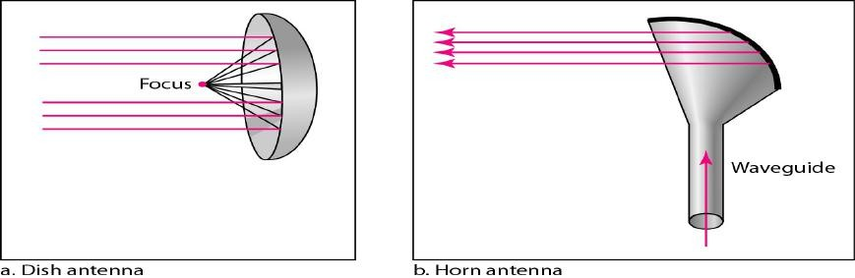
Microwaves need unidirectional antennas that send out signals in one direction.
Two types of antennas are used for microwave communications: the parabolic dish and the horn

Slide 166
THANK YOU

